Slide 1
Detection of Cancer using Biopsy Images and DNNs

Slide 2
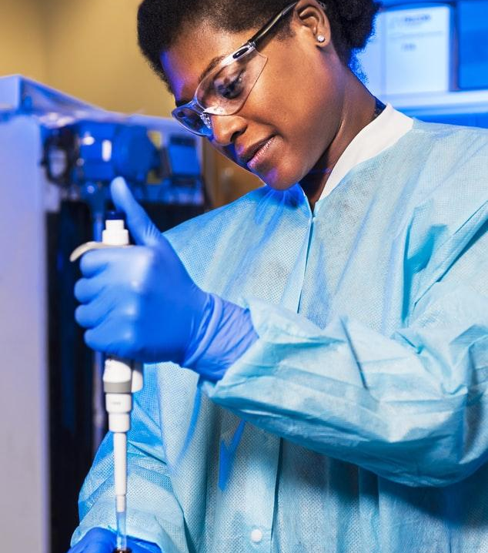
Hello!
I am Dwayne D Costa
I am here because I love research and want to spread awareness on cancer.

Slide 3
Research Background
Cancer in layman terms is a condition caused due to chronic inflammation of tissues.
And if ignored would spread over time causing metastasis and DNA damage.
Cancer often gets overlooked due to absence of its symptoms during a health checkup.

Slide 4
10,000,000
Cancer is alone responsible for these many deaths in 2020

Slide 5
Regions with the highest concentration of cancer cases

Slide 6
Motivation & Research Gap
Cancer tends to recurr sometimes even though its been cured once.
During this time, absent traits can be identified.
As a result there is a void for the detection of cancer mechanisms.

Slide 7
Big concept
Main aim of the research is creation of a mechanism to detect the existence of cancer tissues in a blood smear which exists in the dataset in the form of image scans. This would aid in the early detection of cancers in patients and warn them to access medical help.

Slide 8
Literature Review
The B-Spline method is used along with G-CNN based lie groups to helps in standardisation by increasing the number of kernel methods (Bekkers and E.J., 2019).
The methodology utilised by Co-correction tends to target image classification models used for classifying medical images by helping in increasing their accuracies (Liu et al., 2021).

Slide 9
Methodology
Dataset has been acquired from Kaggle.
During EDA, the training dataset is split into 80% training and 20% validation.
Pre-trained models of image classification are trained on the dataset to obtain the highest validation accuracy.
Model with the highest accuracy undergoes evaluation with the test data and generates a prediction.
The final model is deployed.

Slide 10
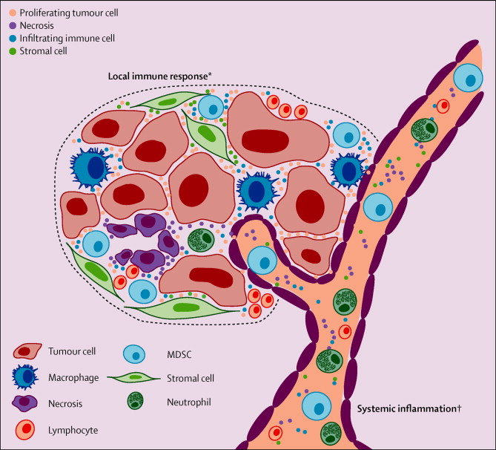
A picture is worth a thousand words
This picture depicts what a chronic inflammation of what a cancerous tissiue looks like.

Slide 11
Results and Discussion
Image classification model VGG16 obtained the highest validation accuracy and was evaluated alongside the test data.
The test data generator is later used to obtain a prediction.

Slide 12
Results to compare
 | VGG16 | ResNet50 | Inception_V3 | EfficientNet
Accuracy | 85.22% | 75.20% | 78.78% | 77.80%
Validation Accuracy | 86.04% | 66.85% | 81.43% | 81.34%
Loss | 36.05% | 51.96% | 45.81% | 47.65%
Validation Loss | 34.25% | 69.16% | 41.58% | 40.87%

Slide 13
Impacts and Implications
This technology would result in people getting the correct dosage of medicine at the right time so as to prevent recurrence.
With the future adoption of this mechanism there could a predicted gradual decline in cancer cases over a period of time.

Slide 14
References
Bekkers, E.J., 2019. B-spline cnns on lie groups. arXiv preprint arXiv:1909.12057.
Liu, J., Li, R. and Sun, C., 2021. Co-correcting: noise-tolerant medical image classification via mutual label correction. IEEE Transactions on Medical Imaging, 40(12), pp.3580-3592.
Selvan, R. and Dam, E.B., 2020, September. Tensor networks for medical image classification. In Medical Imaging with Deep Learning (pp. 721-732). PMLR.

Slide 15
Thanks!
Any questions?
You can find me at:
@dwayne68367
dwayne68367@gmail.com

